Slide 1
LScode
-Lets make better future with better Farming

Slide 2
TEAM MEMBERS
Team Lead-1:Shivamani
Team Member-2:lakshya
Team Member-3: sri harsha
Team Member-4:sai bhargavi
COLLEGE :-VASAVI COLLEGE OF ENGENEERING

Slide 3
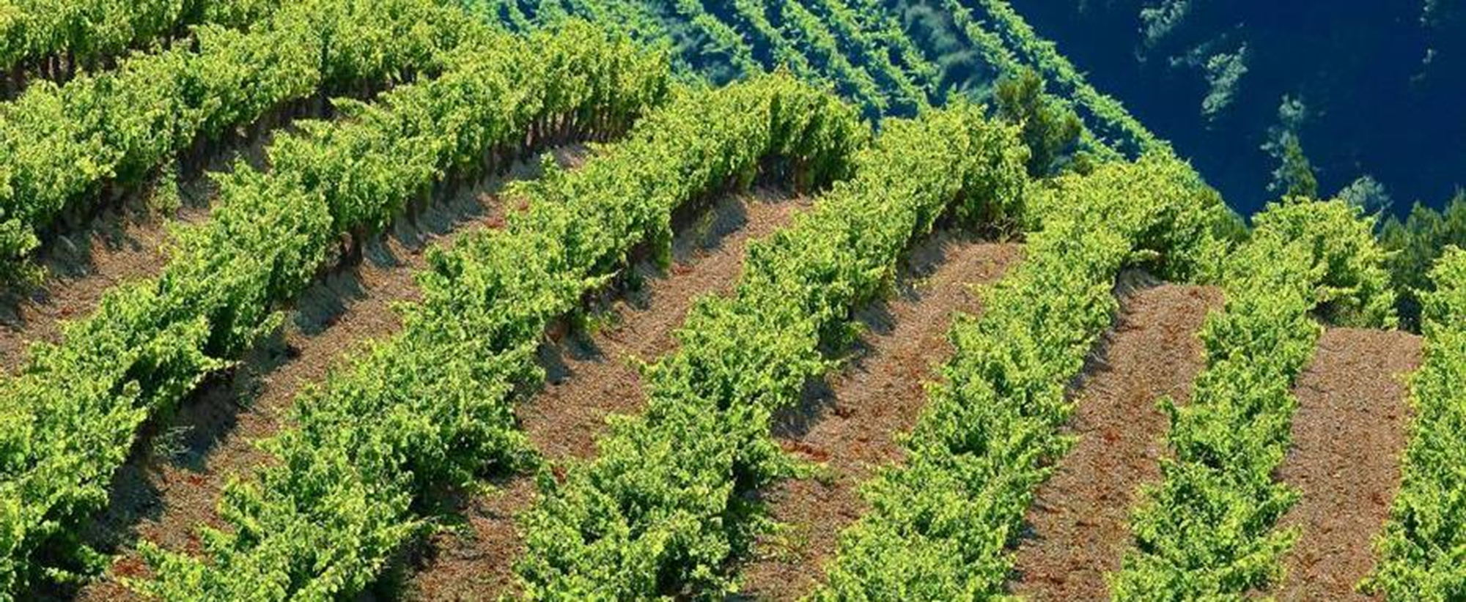
Domain:- AGROTECH
Problem Statement: Estimation Of Crop Yield Based On Seed Quality

Slide 4


Slide 5
1.ABSTRACT
________
->The Key factors which affect production of crop includes soil ingredients(N,P,K), quality of seed, weather conditions(like temperature, humidity, rainfall)
->After many background studies, we are here with a model which helps to get better profits.
->A clear information is achieved regarding types of fertilizers, average field, expected Market prices.
->This helps farmers to analyze and take precautionary measures return help in gaining profits. Using algorithms helps us to provide data with good accuracy.

Slide 6
SOLUTION:-
______
SEED QUALITY:
To let us know the seed quality,
we provide an option for the user to Choose the Crop to be grown and the Certification tag Colour on the seeds packet.
From that we get to know the purity of the seeds being used for the crop.
FERTILITY OF LAND:
We can get this information in 2 ways:
1. Getting Pre-Existing data(if the fertility test has already done) directly
from the user as the input.
2. Book a fertility test for the soil and we act as intermediate between the
user and the fertility test center and trace the information from the center.

Slide 7
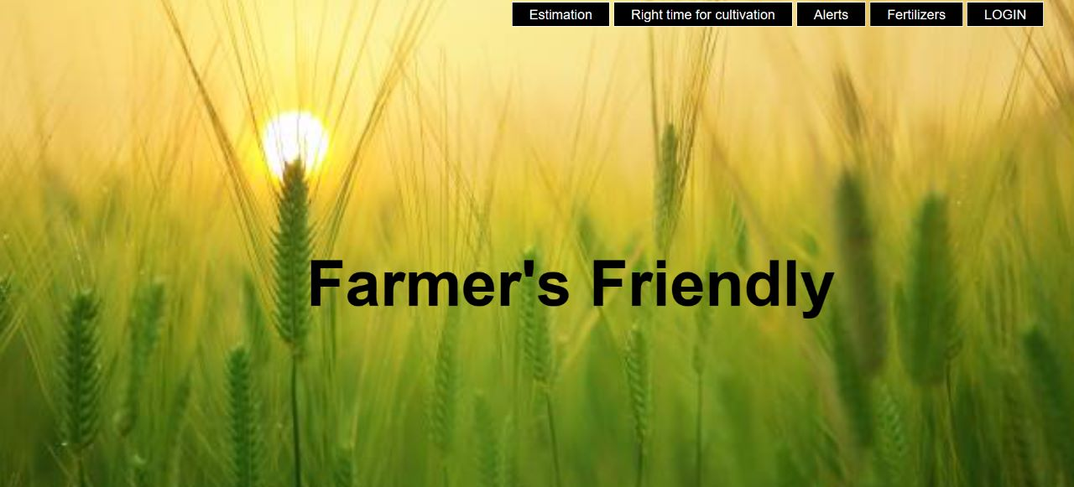

Slide 8
LANDSCAPE:
*We ask the user to enter the Survey Number of the user’s land
From the results of the Fertility Test, we get the details such as
1. pH of the soil.
2. Amount of nutrients(N,P,K) present in the soil.
By analysing data we suggest the users the
fertilizers to be used along with quantity for better production.
we compare those with the weather patterns of the area and suggest the user with the right time for cultivation.

Slide 9
How we analyze profits?
IMPLEMENTATION DETAILS
We Estimate the investment in seeds as follows:
We assume the worst case that is 60kg of seeds/hectare.
cost of the seeds depend on purity, which is taken from the government source and can calculate the amount spent on seeds.(Cost of 1 kg*Total quantity of seeds).
We can Estimate the investment in fertilizers as follows:
As we know the N,P,K and pH values and the Crop, we can know
the fertilizers that are needed to be used for the better yield in
Quantity along with the Cost.
Along with this farmer also has some additional investments.(like labor charge, water resources..)

Slide 10
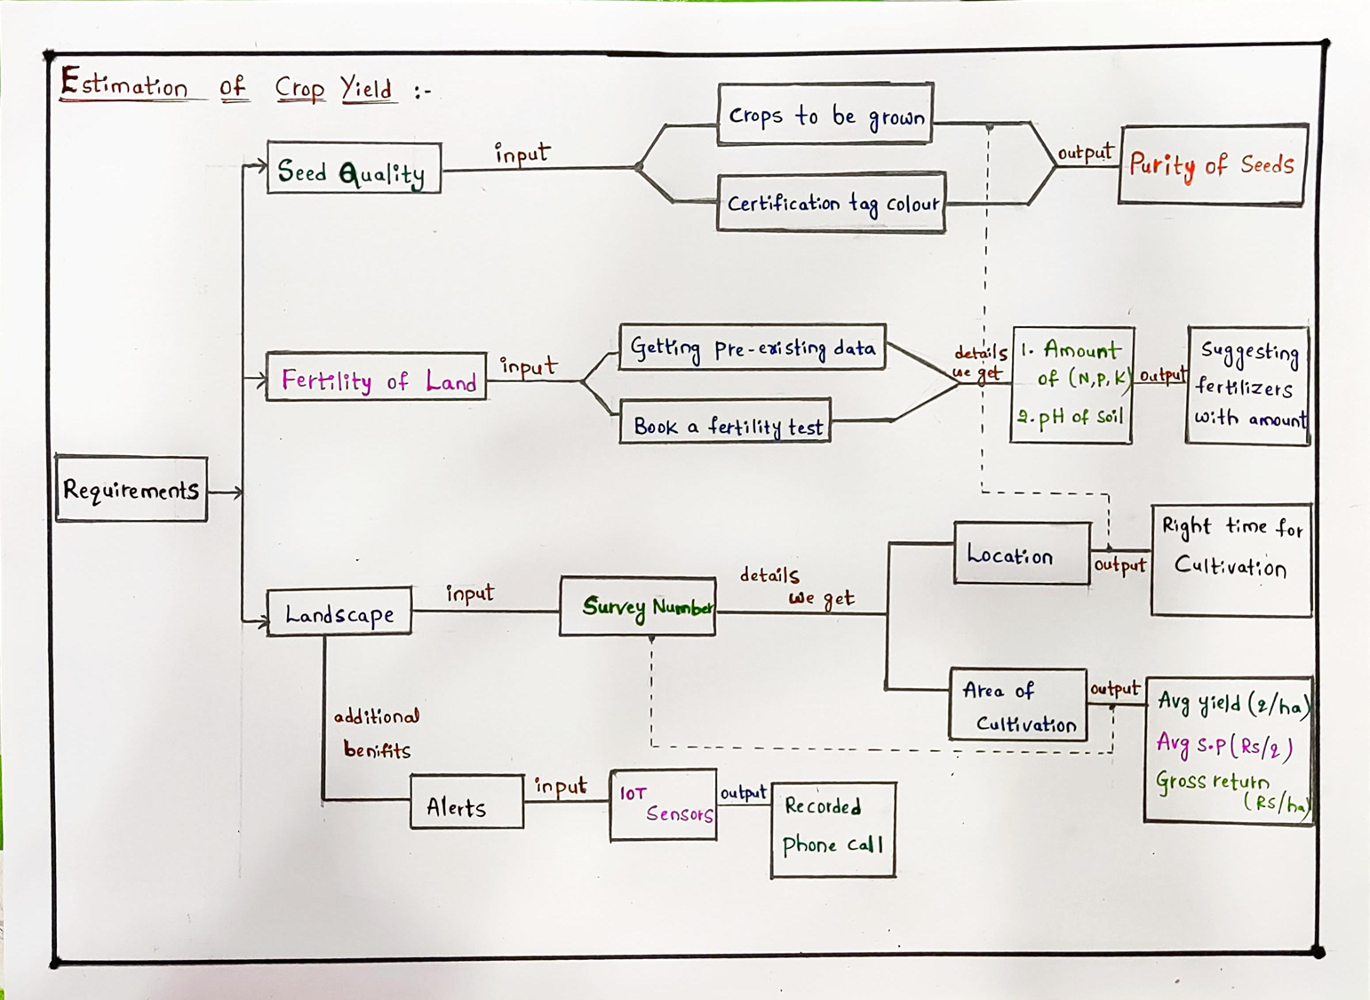
FLOWCHART

Slide 11
Objective and scope of solution
OBJECTIVE:
To benefit the farmers suggesting right time for cultivation, fertilizers, sending alert messages.
Using machine learning and python algorithms to predict the crop yield.
SCOPE OF SOLUTION:
User friendly and easy to understand by the user.
Helps the farmers with better profits.
Using the other high efficient algorithms helps to enhance the efficiency of system in future.

Slide 12
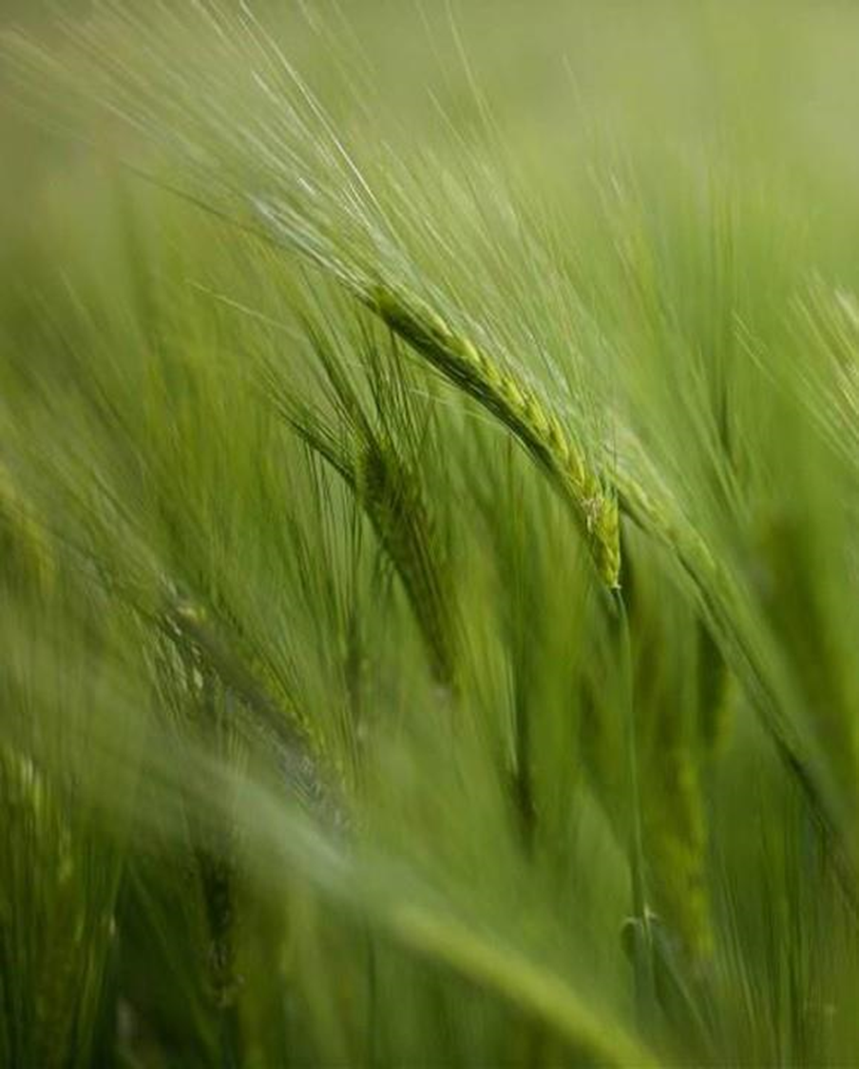
-:Resources required:-
IoT Sensors
->Esp32
->DHT11
FRONTEND AND BACKEND
->Javascript
-> Html&Css

Slide 13
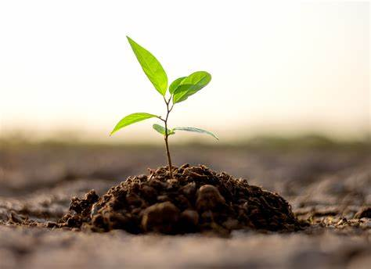
“A farmer is a magician who produces money from the mud.”

Slide 14
THANKS!

